Slide 1

TellCo Data Engineering & EDA Pipeline
Aishwarya Kumar Singh
Intern – Nexthikes IT Solution
Saturday, December 20, 2025

Slide 2

Introduction
This project implements an end-to-end data processing and analytics pipeline for large telecom datasets using Python.
The pipeline reads raw data line by line, performs data cleaning and transformation in memory, and stores optimized outputs in Parquet format.
The processed data is then converted into a multi-sheet Excel analytical report for business analysis.
Throughout the execution, detailed logging is maintained to ensure transparency, traceability, and error tracking.

Slide 3

Agenda
Understand business requirements and overall data flow
Read and preprocess raw data with validation and cleaning
Generate optimized Parquet files for efficient data storage
Create a multi-sheet Excel report for comprehensive EDA
Implement detailed logging and review final outputs

Slide 4

Primary Goals
Build a scalable end-to-end data processing pipeline using Python
Perform robust data cleaning, validation, and transformation on raw telecom data
Store processed data efficiently in Parquet format for performance optimization
Generate a multi-sheet Excel analytical report for structured EDA and insights
Enable traceability and reliability through detailed execution logging

Slide 5

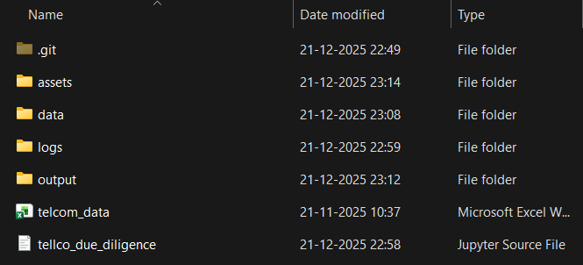
Folder Structure & Analysis Report Screenshots
project/
│
├── data/
│ ├── telcom_data.xlsx
│ ├── cleaned_telecom_data.parquet
│ ├── univariate_summary.parquet
│ ├── user_engagement
│ ├── user_experience
│ ├── user_overview_analysis
│ ├── user_satisfaction
│
├── output/
│ ├── telecom_analysis.xlsx
│ ├── plots
│ ├── univariate
│ ├── bivariate
│ ├── multivariate
│
├── logs/
│ ├── telecom_pipeline.log
│
└── tellco_due_diligence.ipynb

Slide 6
“Without data, you’re just another person with an opinion.”
W. Edwards Deming

Slide 7
Data Cleaning and Pre-processing
Standardized column names
Handled missing values systematically
Type coercion for numeric columns
Removed duplicates where applicable
The data cleaning and pre-processing were critical to ensure the reliability and accuracy of telecom usage analysis.
The raw dataset contained missing values, inconsistent data types, duplicate records, and outliers that could distort analytical insights.

Slide 8

Processing Strategy
Notebook executes cells sequentially.
Each transformation step is isolated and logged.
No in-place Excel editing to avoid performance bottlenecks.
Memory-level cleaning before persistence.

Slide 9

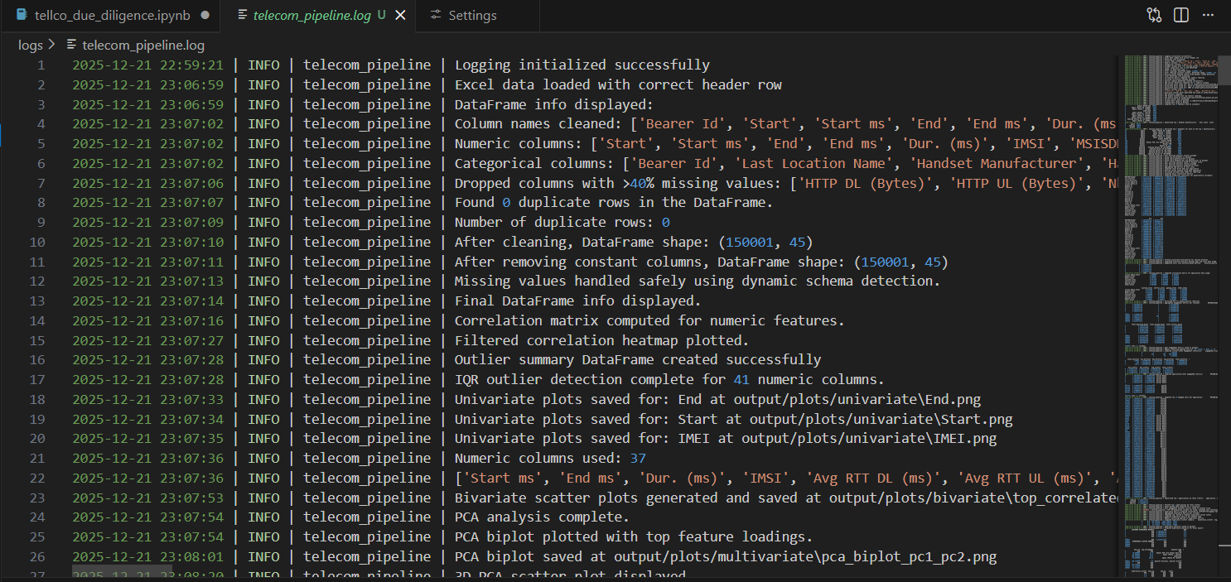
Logging Implementation
Centralized logger configured at pipeline start.
INFO logs for every major step.
Column-level logs for transformations.
Error handling with descriptive messages.
Log file saved under logs/ directory
This is important implementation to track
the activities in the pipeline of the project execution.

Slide 10
Why Parquet Format?
Parquet is a columnar storage file format used for large-scale data analytics. It stores data column-wise (not row-wise), making queries faster and more memory-efficient. It preserves schema and data types, unlike Excel or CSV. It supports compression and efficient reads, which is why it’s ideal for big data and EDA pipelines. In short: Parquet = fast, compact, and analysis-ready data storage.
Columnar storage → faster analytics.
Highly compressed → reduced disk size.
Schema preserved across reads.
Efficient for large datasets.

Slide 11
Parquet Generation Flow
Parquet generation was utilized to handle the large excel data to avoid the unexpected workflow errors and to smoothly modify the data in the sheet.
Cleaned pandas DataFrame prepared in memory.
Data validated before persistence.
Written using df.to_parquet().
Single source of truth for downstream analysis.

Slide 12

Data Manipulation
Visualization
Styling
Logging
Pandas 🐼
NumPy 🔢 – The core numerical computing library in Python, providing fast array operations, mathematical functions, and the foundation for scientific computing.
Matplotlib 📊 – A versatile plotting library in Python that enables the creation of a wide range of static, animated, and interactive visualizations.
Seaborn 🎨 – A statistical data visualization library built on Matplotlib, making it easy to create attractive and informative plots with minimal code.
openpyxl 📘 – A Python library to read, write, and style Excel (.xlsx) files, enabling automated reporting, formatting, and multi‑sheet data exports directly from code.
Logging: Python’s built logging module lets us record what the program is doing(info, warning, errors) in a structured, configurable, and production-ready way. It is much better than print()
It is widely used machine learning library for providing simple, and efficient tools that are used for preprocessing, modelling, evaluation, and prediction.

Slide 13

Excel Generation Strategy
Parquet read back into pandas.
Multiple analysis DataFrames created.
ExcelWriter used with openpyxl engine.
Each analysis written to a separate sheet

Slide 14
Excel Sheets Created
The following excel sheets were created in the entire analysis pipeline through python code. These can be seen inside the workbook named as “telecom_data_analysis.xlsx”
Original / Cleaned Telecom Data
Data Dictionary
Missing Value Analysis
Univariate Analysis
Bivariate Analysis
Multivariate (PCA) Analysis
Outlier Analysis
User Overview, Engagement, Experience, Satisfaction

Slide 15
Analysis and Graphs
Univariate Analysis
Explored single features’ distributions, central tendency, and spread using histograms, bar plots, and boxplots to detect skewness and outliers.
Excel workbook and its worksheets were created using code, with each sheet uniquely capturing specific analysis results, ensuring automation, transparency, and reproducibility throughout.
Excel sheets were directly updated in the workbook once any analysis is completed and workbook can be reopened to see the sheets those were added.
To see the graphs and the worksheets, one needs to wait for generation of the images(plots/graphs) and the workbook. Once done, they can be seen in the respective folders and workbook.
Bivariate Analysis
Examined relationships between two variables with scatter plots, correlation heatmaps, and grouped bar charts to identify trends and associations.
Multivariate Analysis/ PCA
Analyzed interactions among multiple features using pair plots, heatmaps, and 3D scatter plots to uncover deeper patterns and dependencies.
Outlier Report (Numeric)
Code calculated outliers using IQR, logged capped values into a new sheet, and styled table for transparent stakeholder reporting.

Slide 16
Performance Optimization
Avoided repeated Excel writes.
Used Parquet as intermediate storage.
Vectorized pandas operations.
Batch Excel writing in a single writer context.

Slide 17
Business Value Delivered
Scalable data processing pipeline.
Audit-ready logs for compliance.
Reusable Parquet datasets.
Comprehensive Excel-based EDA for stakeholders.

Slide 18

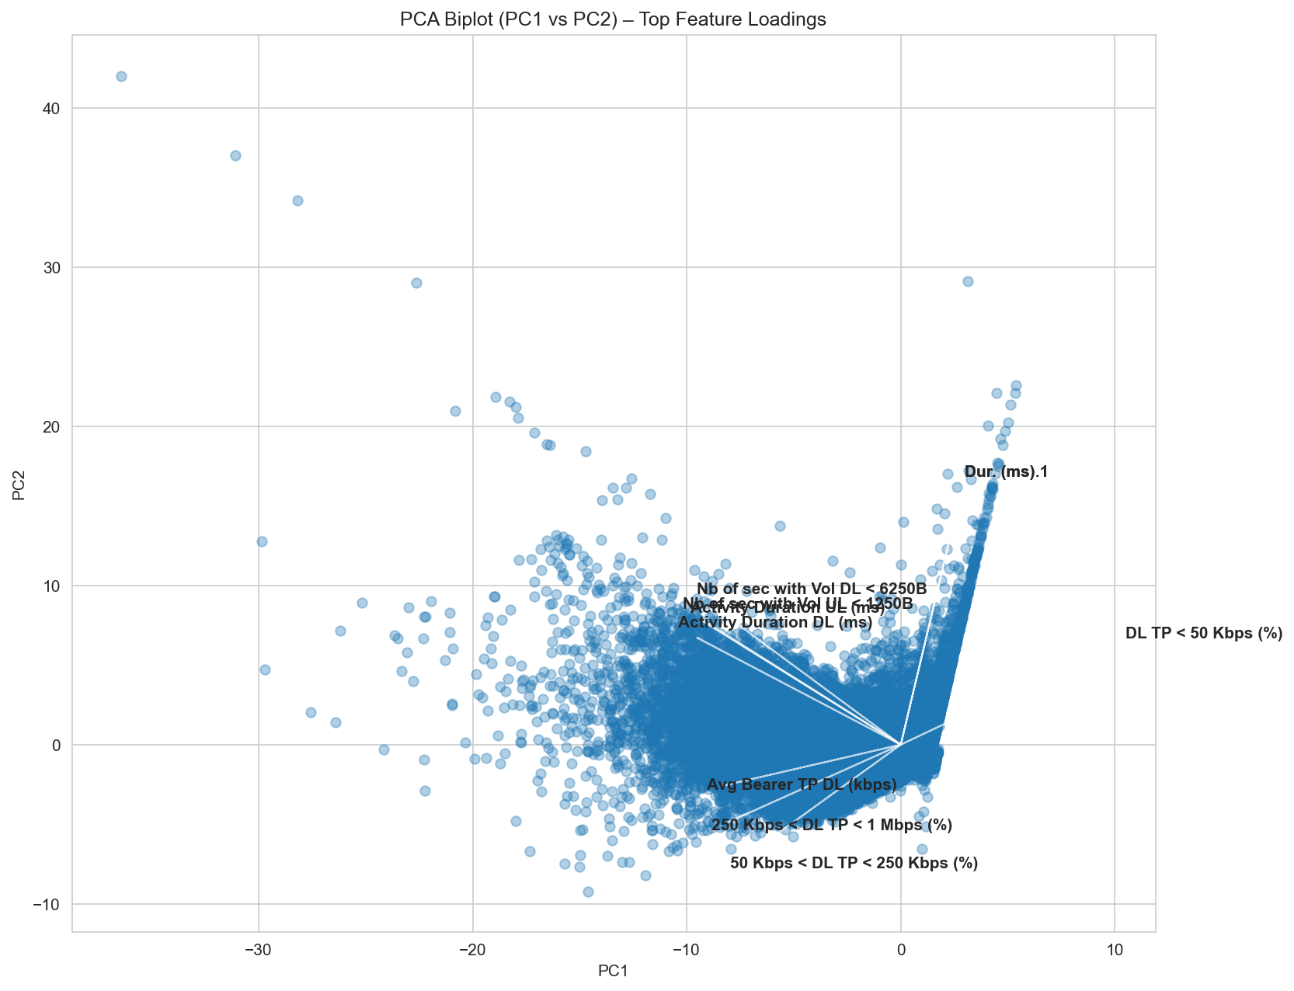
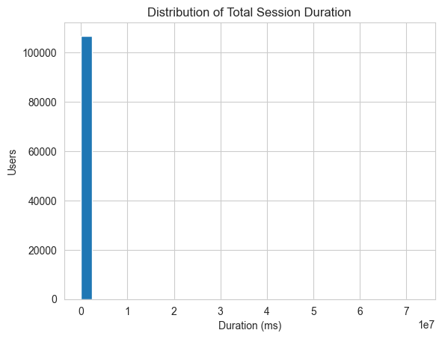
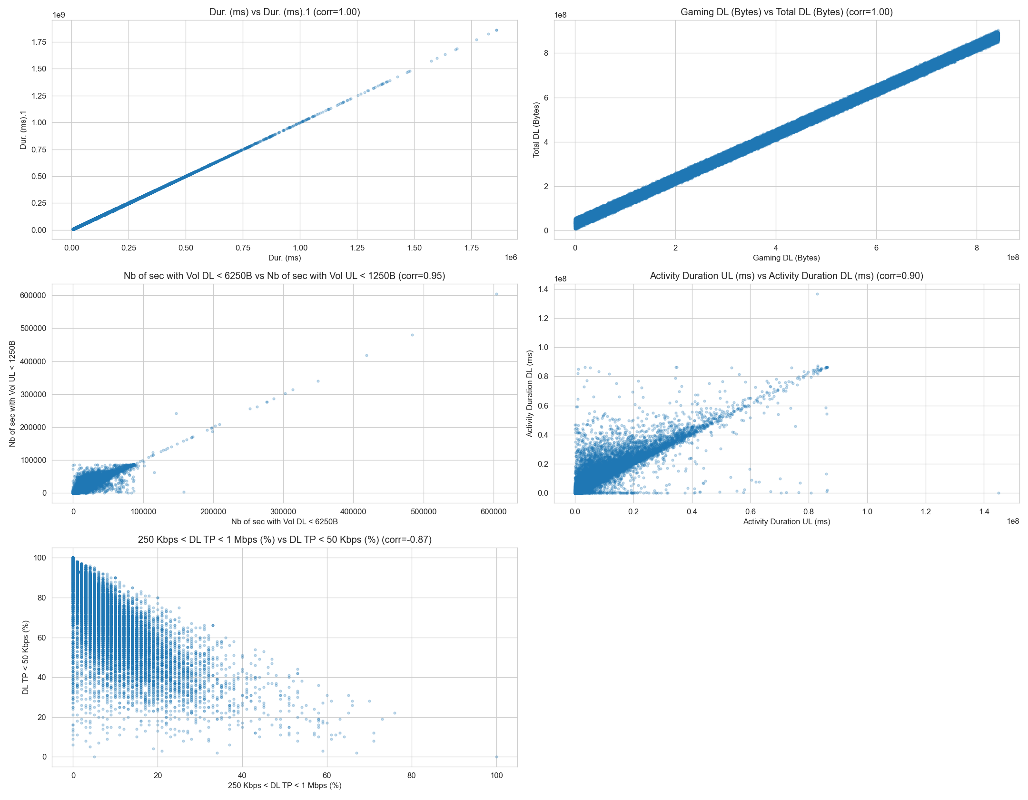
Screenshots

Slide 19
Conclusion
End-to-end data pipeline implemented.
Efficient handling of large datasets.
Clear separation of cleaning, storage, and reporting.
Robust logging ensures transparency and maintainability.
Helps stakeholders make informed, data-driven decisions.

Slide 20
Thankyou
Aishwarya Kumar Singh
aishsingh702@gmail.com
www.github.com/aishks14

